Slide 1
    ReSPECT
Recommended
Summary
Plan for
Emergency
Care and
Treatment
ReSPECT

Slide 2
    Learning Objectives
By studying this presentation you should be prepared to:
discuss potentially life-sustaining treatments in the context
of a person’s overall goals of care
make shared decisions whenever possible
practise and promote good decision-making
communicate effectively
practise and promote high-quality documentation
use ReSPECT to help to achieve these objectives
ReSPECT

Slide 3
    ReSPECT — Presentation Contents
Background to ReSPECT
What ReSPECT is
Aims of ReSPECT
Who ReSPECT is for
How to initiate ReSPECT
When to review
ReSPECT – who keeps it?
Summary
ReSPECT

Slide 4
    Background — the evidence
October 2014
DNACPR
from
best practice
to
best policy and practice
http://www.journalslibrary.nihr.ac.uk/
hsdr/volume-4/issue-11#abstract
ReSPECT

Slide 5
    Background
DNACPR decisions and discussions have led to:
negative patient/public perceptions
negative clinicians’ perceptions
complaints
litigation
negative media reports
ReSPECT

Slide 6
    Background
Common themes
Poor or absent communication
Bad decision-making
Poor or absent documentation
ReSPECT

Slide 7
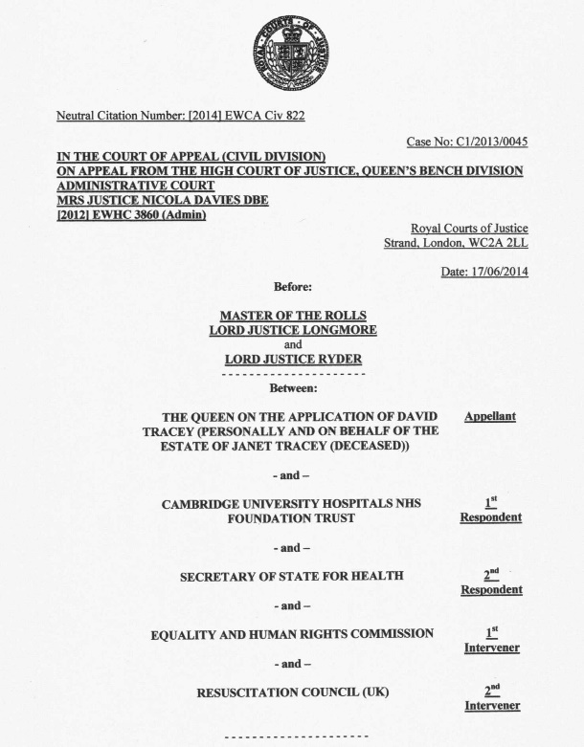
    Background
Court of Appeal 2014
DNACPR decisions
“… presumption in favour of patient involvement...”
ReSPECT

Slide 8
    Background
“… presumption in favour of patient involvement...”
… fewer DNACPR decisions…
...but surely leaving someone ‘for CPR’
when they may not want it is no less
a breach of their human rights
ReSPECT

Slide 9
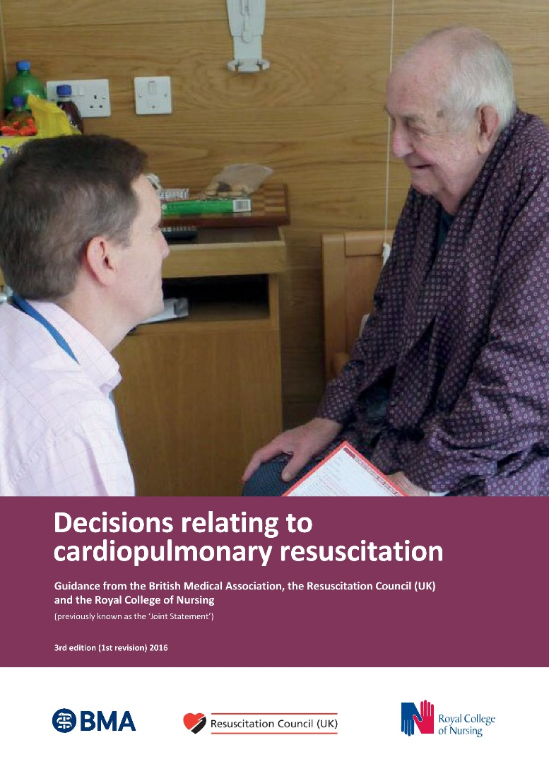
    Background
National guidance on
CPR decisions
“Where no explicit decision…
…there should be an initial presumption in favour of CPR.”
ReSPECT

Slide 10
    Background
but
“…an initial presumption in favour of CPR…”
…does not mean indiscriminate application of CPR that is of no benefit and not in a person’s best interests
ReSPECT

Slide 11
    Background
National guidance on
CPR decisions
“…there are clear benefits
in having (CPR) decisions
recorded on standard forms
that are…recognised across geographical and organisational boundaries within the UK.”
ReSPECT

Slide 12
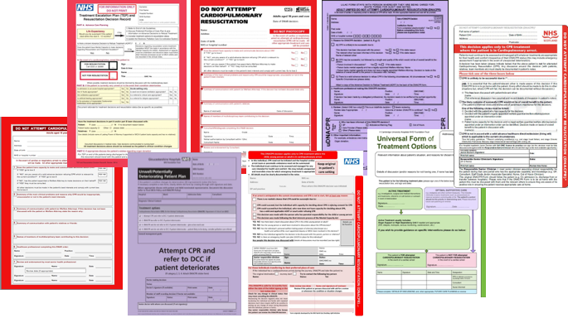
    Background
but actually…
ReSPECT

Slide 13
    What is ReSPECT?
ReSPECT – an alternative process for discussing, making and recording recommendations about future emergency care and treatment, including CPR
ReSPECT – developed by many stakeholders, including patients, doctors, nurses and ambulance clinicians, to try to achieve a process that will be adopted nationally
ReSPECT focuses on treatments to be considered as well as those that are not wanted or would not work
ReSPECT encourages people to plan ahead for their care and
treatment in a future emergency in which they are unable to make decisions
ReSPECT

Slide 14
    ReSPECT — what’s needed?
A change of culture from:
health and care professionals
members of the public
Are you ready to embrace it?
ReSPECT

Slide 15
    ReSPECT — aims
More conversations between people and clinicians
More planning in advance
Good communication
Good decision-making
Shared decision-making whenever possible
Good documentation
Better care
ReSPECT

Slide 16
    ReSPECT — who is it for?
Everyone, with increasing relevance for those:
▫ with particular healthcare needs
▫ nearing the end of their lives or at risk of cardiac arrest
▫ who want to record their preferences for any reason
A ReSPECT form is best completed when a person is relatively well, so that their preferences and agreed clinical recommendations are known if a crisis occurs
If an emergency occurs in someone with no ReSPECT form, consider discussing and completing it as soon as possible (before or after hospital admission)
ReSPECT

Slide 17
    ReSPECT — other features
ReSPECT can be used for people of any age
When used for a child or young person there must be appropriate parental involvement
ReSPECT can complement other documents such as advance care plans but does not replace them
If a person has a completed ReSPECT form there should be no need for a separate CPR decision form
ReSPECT

Slide 18
    How to initiate ReSPECT
This MUST begin with a conversation with the person or - in the case of a child - their parent(s)
If they don’t have capacity for these decisions –
record the capacity assessment in their health record and have a conversation with family or other representatives whenever possible
Make decisions when they are needed
If no discussion is possible, record the reasons
ReSPECT

Slide 19
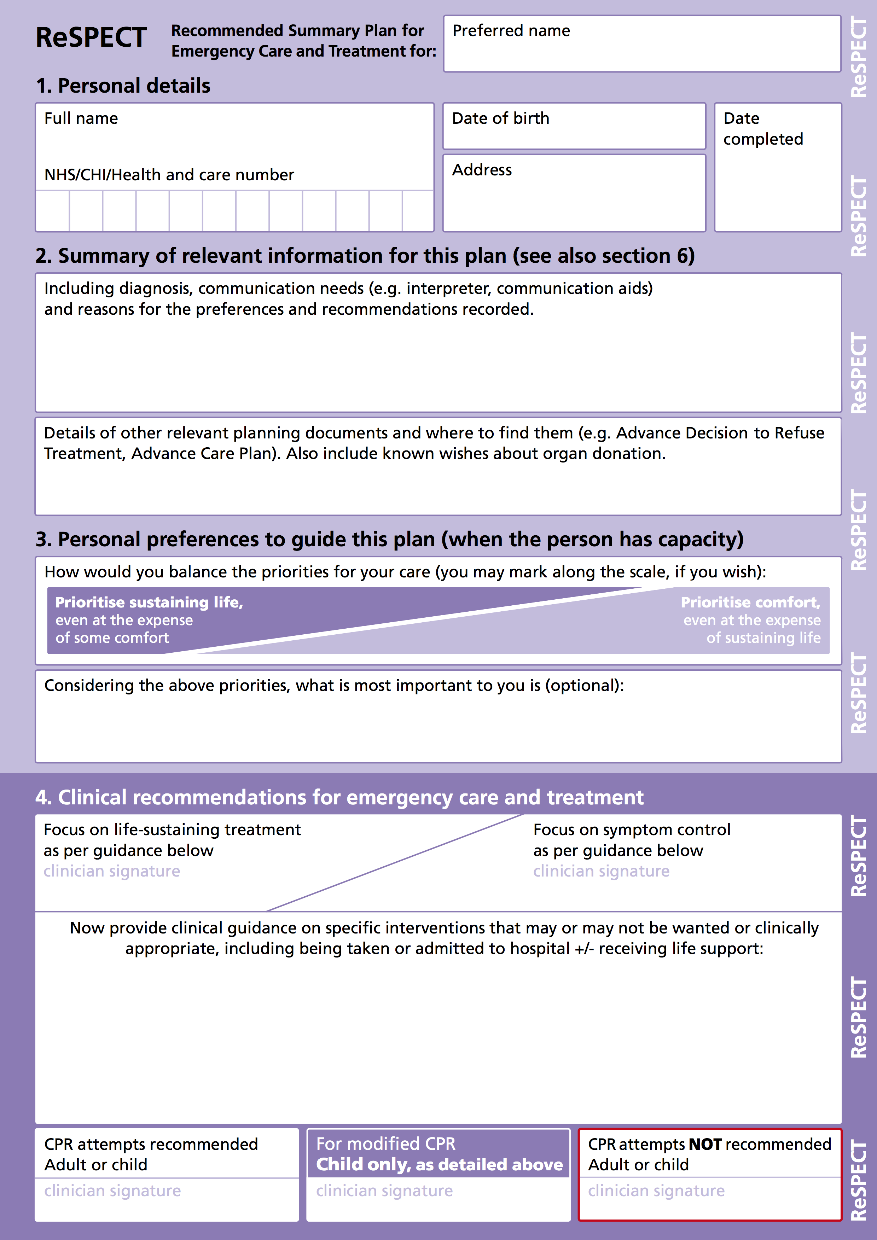
    How to initiate ReSPECT
The ReSPECT form can
be used to support
discussions with patients
(and/or those close
to patients)
Work through and complete
each section in sequence
ReSPECT

Slide 20
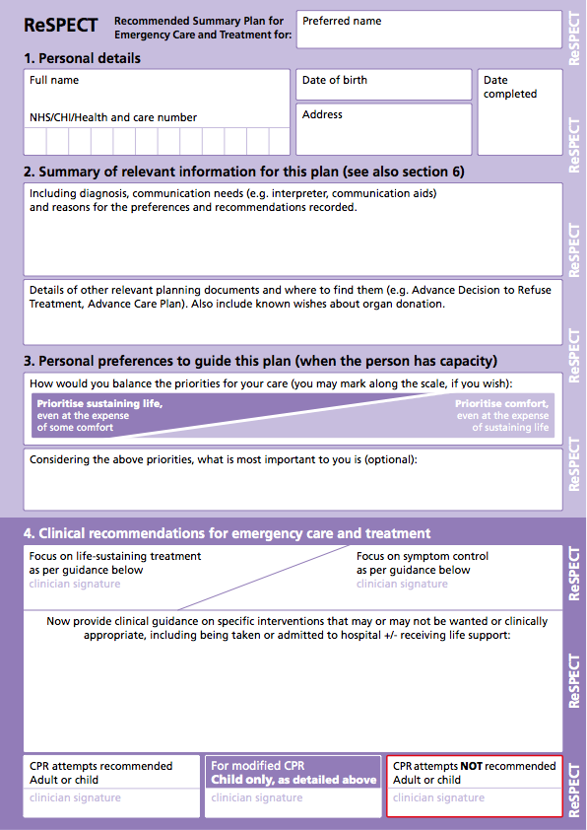
    How to initiate ReSPECT
Use the first (lilac) section to:
record the person's details and the date
explore and enhance their
understanding of their condition
and summarise relevant detail
record details of other planning
documents
help them to identify priorities
for their care
help them to identify what is
important to them (if they want to)
ReSPECT

Slide 21
    How to initiate ReSPECT
Use section 4 (purple) to record the following recommendations
(agreed whenever possible):
the main focus of treatment
specific types of care and treatment
▫ that the person would or would not want
▫ that would not work in their situation
whether or not attempted CPR is
recommended
Remember - these recommendations will guide clinicians having to make immediate decisions in a crisis, so clarity and adequate detail are crucial

Slide 22
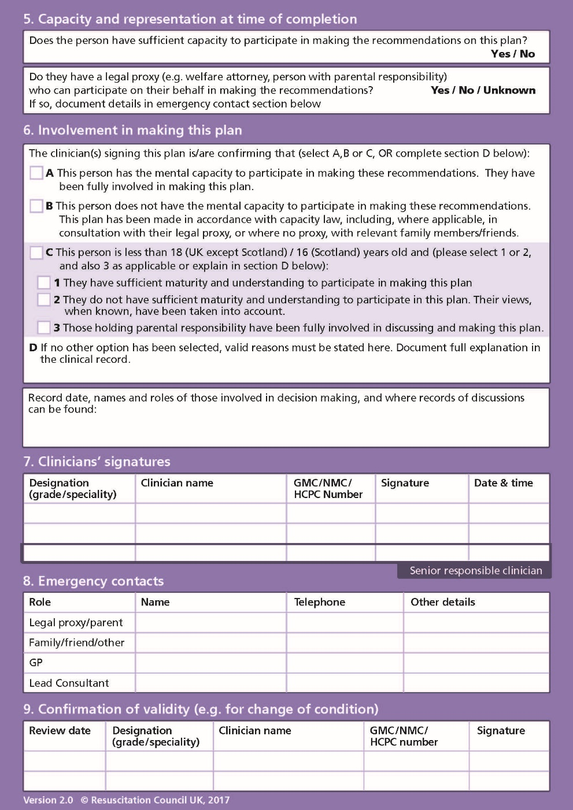
    How to initiate ReSPECT
Having completed discussion,
shared decision-making and
recording…
… turn over the form to verify
the basis for the agreed
recommendations
ReSPECT

Slide 23
    How to initiate ReSPECT
Be sure to complete sections 5-8 fully
You must sign section 7 to confirm that all
statements and recommendations are valid
If you are not the senior responsible clinician
make sure that they are aware and in agreement with this plan and its content -ensure that they sign to endorse it as soon as is practicable
Leave section 9 blank for use by a clinician
reviewing this ReSPECT at a future time
ReSPECT

Slide 24
    ReSPECT — review
The recommendations on the form should be reviewed:
▫ if the person or those close to them requests this
▫ if the person’s condition changes
▫ if the person moves from one care setting to another
(including in-hospital transfer e.g. to or from ICU)
  Consider carefully whether the person (or if they lack capacity their representatives) should be involved – if in doubt, involve them
  Frequency of review of ReSPECT recommendations is determined by each individual circumstance – e.g. frequent review in an acute illness but not in an advanced, irreversible terminal illness
  Consider this option at each clinical assessment
ReSPECT

Slide 25
    ReSPECT — who keeps it?
The recommendations on the form are (whenever possible) shared decisions, made for the benefit of the person to try to ensure that future decisions about their care are in their best interests
Paper versions of the form should be kept by or with the person and should be accessible immediately to any clinician needing to make an immediate decision in a crisis
Electronic versions must be similarly accessible
Local systems must ensure that all versions are included in any cancellation or change to a ReSPECT form
ReSPECT

Slide 26
    ReSPECT — summary
Use ReSPECT to help you with good communication,
decision-making and documentation
Start with a conversation with the person or - in the case of a child - their parent(s)
Aim to make shared decisions whenever possible
Work through ReSPECT systematically to establish:
▫ the background to the recommendations
▫ the person’s preferences for care and treatment
▫ agreed (whenever possible) clinical recommendations
Review ReSPECT recommendations according to individual needs
ReSPECT

Slide 27
    ReSPECT — feedback
Your feedback is crucial
ReSPECT aims to be a dynamic process that responds to and develops further from your feedback
ReSPECT

