Slide 1

How to complete a form
A step-by-step guide
ReSPECT (version 1.0)

Slide 2
How to initiate ReSPECT
This MUST begin with a conversation with the person
If they don’t have capacity for these decisions record the capacity assessment in their health record and have a conversation with family or other representatives whenever possible
Make decisions when they are needed
If no discussion is possible, record the reasons
ReSPECT

Slide 3
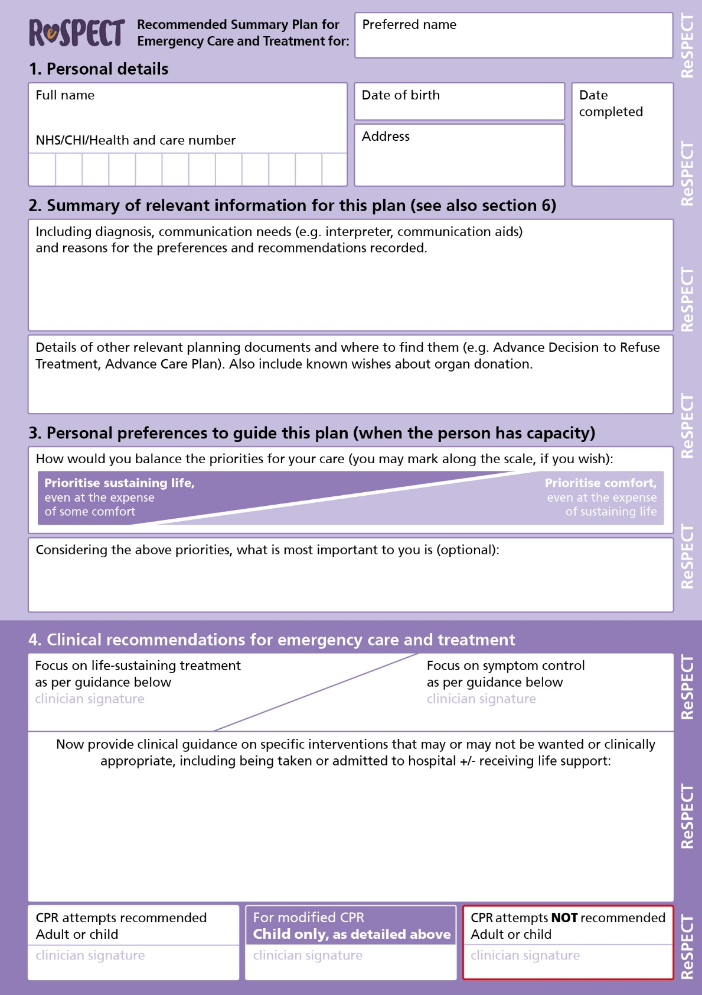
How to initiate ReSPECT
The ReSPECT form can
be used to support
discussions with patients
(and/or those close them)
Work through and complete
each section in sequence
ReSPECT

Slide 4
Professionals who may refer to a ReSPECT form
Ambulance crews
Doctors (all settings and grades)
Nurses (all settings and grades)
Allied health professionals (all settings and grades)
Social care professionals
Remember:
Always consider the likely users
Ensure that recommendations are clear and unambiguous to all potential readers
ReSPECT

Slide 5
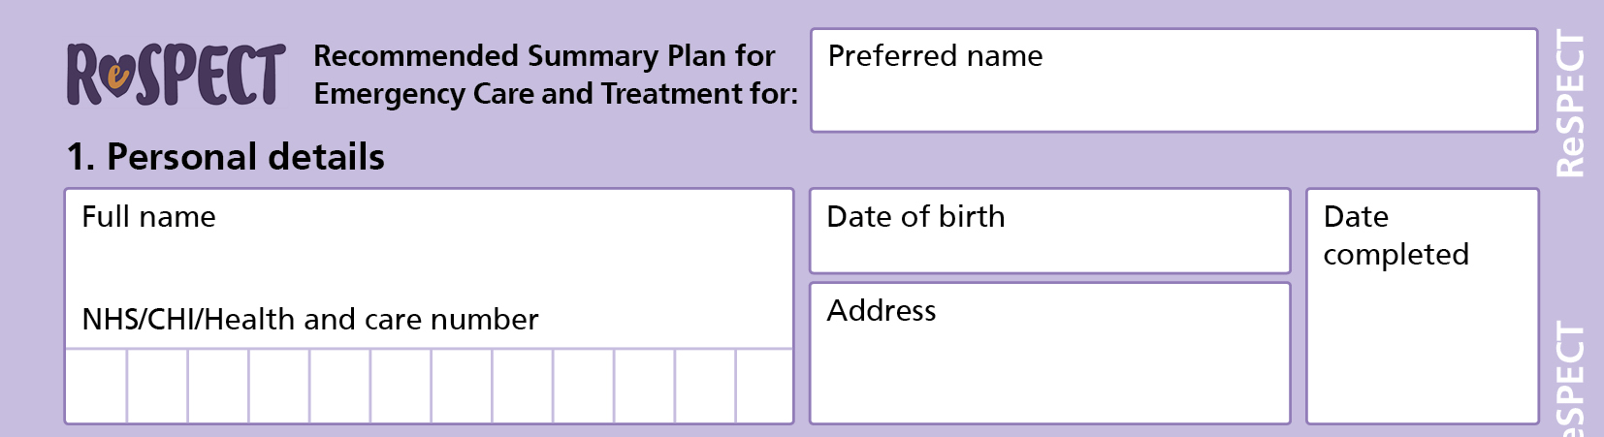
Completing a ReSPECT form – 1
Write legibly!
Ask the person the name by which they would like to be addressed and record it
Insert the person’s full details
Insert the date of completion of the form
ReSPECT

Slide 6
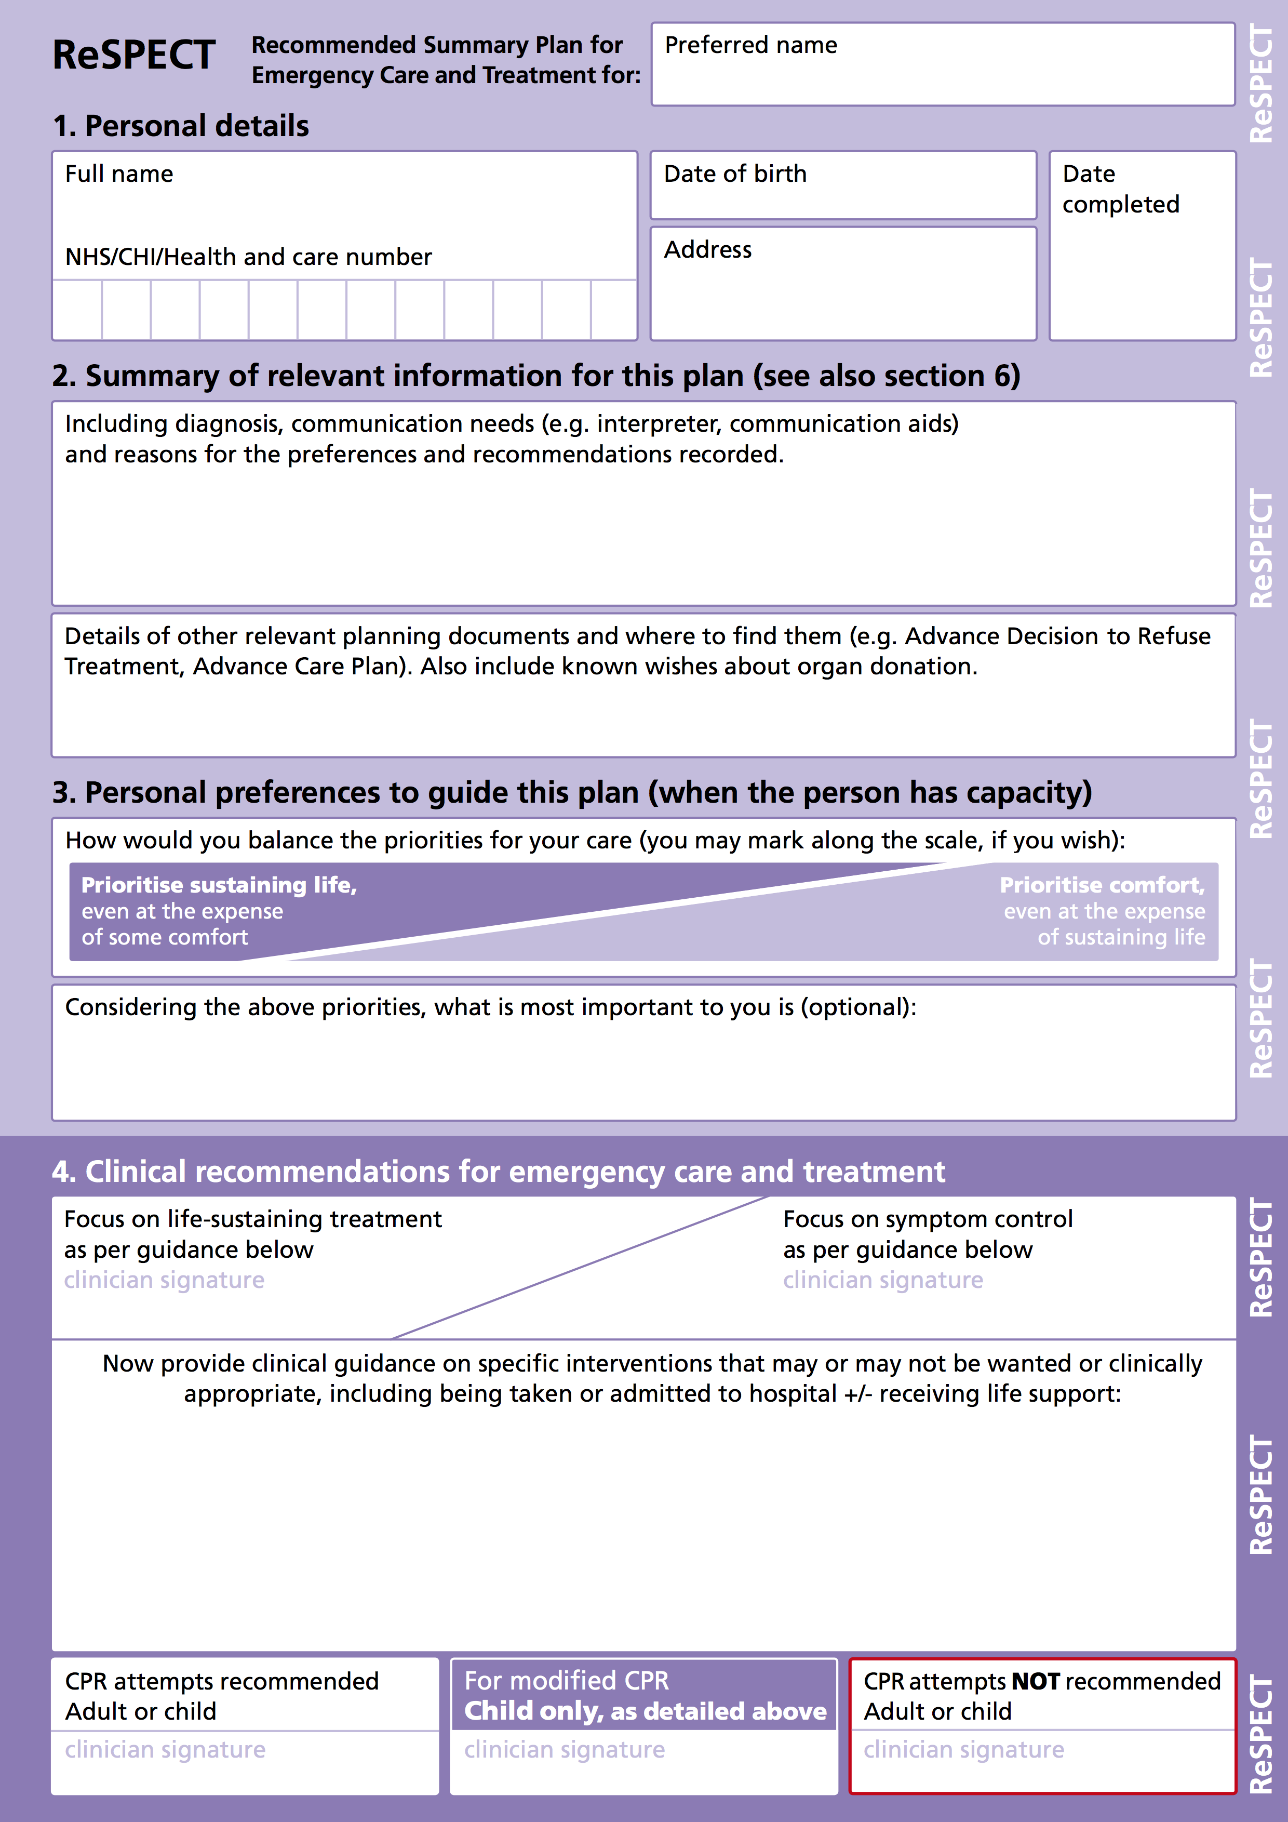
Completing a ReSPECT form – 2
Discuss with the person their condition and prognosis and any special needs (e.g. communication, mobility) - summarise these
Ask about and record details of other plans or documents
ReSPECT

Slide 7
Completing a ReSPECT form – 3
Use the scale to help the person to understand the balance between priorities of care and identify their own priority
Record (if they wish) the aspect(s) of life most important to the person
ReSPECT

Slide 8
Completing a ReSPECT form – 4a
Sign one (agreed whenever possible) main focus of care
List elements of emergency care and treatment that
should be considered
they would not want
would not work in the person’s situation
Include whether or not they would want to be taken to hospital and in what circumstances
ReSPECT

Slide 9
Completing a ReSPECT form – 4b
Remember that all recommendations
should be shared decisions
whenever possible
ReSPECT

Slide 10
Completing a ReSPECT form – 4c
Sign a recommendation about CPR
The middle box is for use only in those children in whom a need for a modified CPR sequence has been identified and agreed
ReSPECT

Slide 11
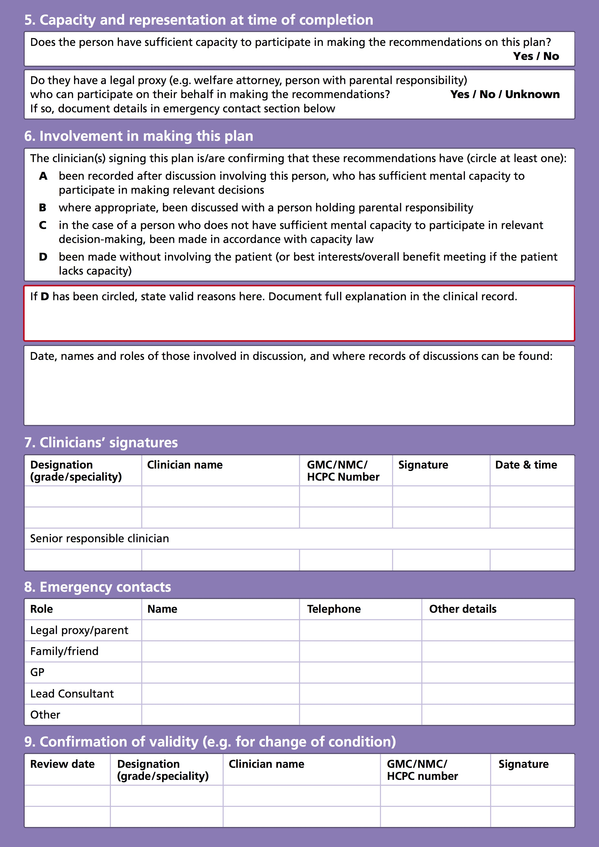
ReSPECT
Having completed discussion, shared decision-making and
recording…
… turn over the form to verify the basis for the agreed recommendations
ReSPECT

Slide 12
Completing a ReSPECT form – 5
If you suspect that the person does not have capacity to participate in decisions about these matters make a formal capacity assessment and record it in the health record
Ask whether or not they have a legal proxy to participate in decision-making on their behalf if they lose or have lost capacity - if so, insert their contact details in section 8
ReSPECT

Slide 13
Completing a ReSPECT form – 6
Circle at least one of A, B, C, D to indicate any involvement of the person or their legal proxy
C includes all recorded decisions that comply with capacity law
If the plan has been made with no involvement of the person or their representative state valid for reasons for this
Record dates of discussions and names and roles of those involved
ReSPECT

Slide 14
Completing ReSPECT form – 7
Complete this line in full to confirm that you have completed the form accurately
The senior responsible clinician should be aware of and agree to this plan. If you are not that clinician they should be asked to endorse it by completing this line at the earliest practicable opportunity
ReSPECT

Slide 15
Completing a ReSPECT form – 8
List name and contact details of all those who must be contacted
and those that the person would want contacted
in an emergency (and are willing to be contacted)
ReSPECT

Slide 16
Completing a ReSPECT form – 9
Leave this box blank at initiation
When a person’s condition changes or they move from one care setting to another (including a change of hospital ward) a senior clinician should review the ReSPECT recommendations, in discussion with the patient unless this is inappropriate and:
sign and date here to confirm that they are still valid OR
cancel this form and create a new revised one
ReSPECT

Slide 17
Summary
Start with a conversation with the person
Aim to make shared decisions whenever possible
Work through ReSPECT systematically to establish: ▫ the background to the recommendations ▫ the person’s preferences for care and treatment ▫ agreed (whenever possible) clinical recommendations
Complete page 2 fully to confirm the validity of the plan
ReSPECT

