Slide 1

How to complete a ReSPECT form
Use and completion of ReSPECT form
for a young person
A step-by-step guide
ReSPECT — young person (version 1.0)

Slide 2
The role of a ReSPECT form for a young person
There are several possible scenarios:
As a universally recognised document completed as an adjunct to an advance care plan to ▫ flag the presence of a more detailed advance care plan ▫ provide a summary of the elements of the detailed plan,
relevant to emergency care
As a document to recommend treatment that should be considered in an emergency
As a record of a medical management order made by the courts
ReSPECT — young person

Slide 3
When to complete a ReSPECT form
During or immediately after completing an advance care planning process
When a young person is known to need specific treatment in an emergency
As a stand-alone document in an acute situation: follow the ‘ReSPECT process’, which we will discuss shortly
After a decision regarding limitation of treatment is issued by the courts
ReSPECT — young person

Slide 4
Professionals who may refer to a ReSPECT form
Ambulance crews
Doctors (all settings and grades)
Nurses (all settings and grades)
Allied health professionals (all settings and grades)
Social care professionals
Remember:
Always consider the likely users
Ensure that recommendations will be clear and unambiguous to all potential readers
ReSPECT — young person

Slide 5
Using ReSPECT to guide discussion about CPR
or other life-sustaining treatment
Begin with a conversation with the young person’s parent(s)
Whenever possible and appropriate: ▫ involve all those with parental responsibility ▫ involve the young person If neither is possible or appropriate record why
Make only the critical treatment decisions that are needed for immediate care
If time allows, use the advance care planning process and use discussions to complete a ReSPECT form
If no discussion is possible, record the reasons
ReSPECT — young person

Slide 6
‘Terminology’
In the slides that follow:
reference to ‘the family’ means the young person and their parents
this may include the wider family if appropriate
reference to ‘parent’ means anyone with parental responsibility
ReSPECT — young person

Slide 7
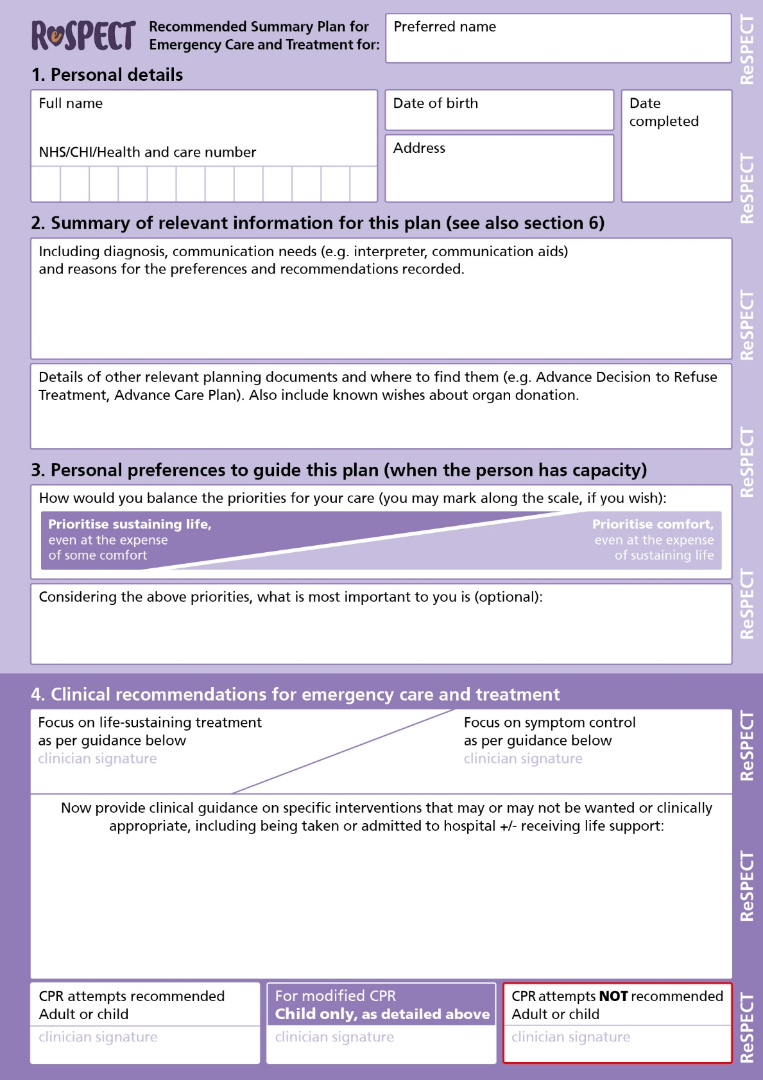
How to initiate ReSPECT
The ReSPECT form may be used to support discussions with the family (but does not have to be used for this)
It is designed to guide conversation, by working through and completing each section in sequence
ReSPECT — young person

Slide 8
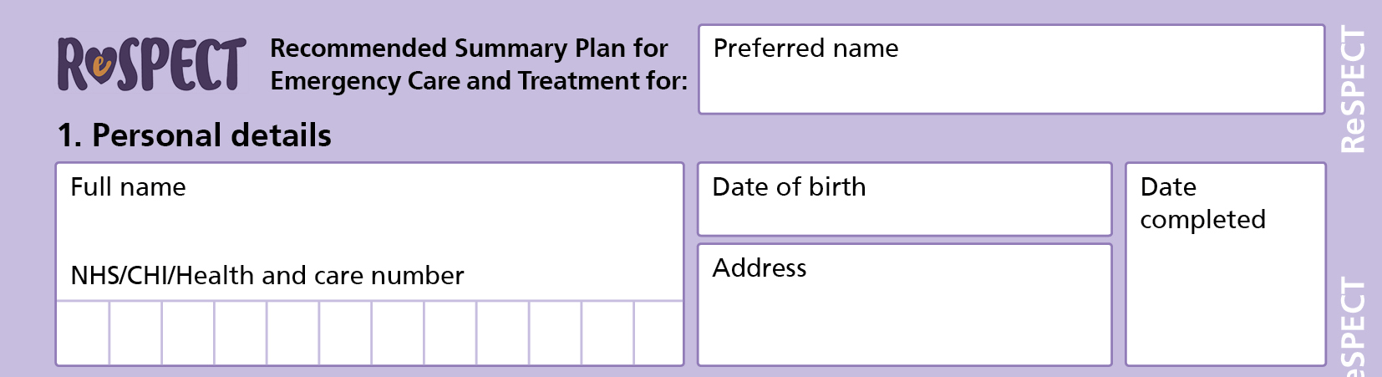
Completing ReSPECT form – 1
Write legibly!
Insert the name the young person likes to use for themselves
Insert the young person’s full details
Insert the date of completion of the form
ReSPECT — young person

Slide 9
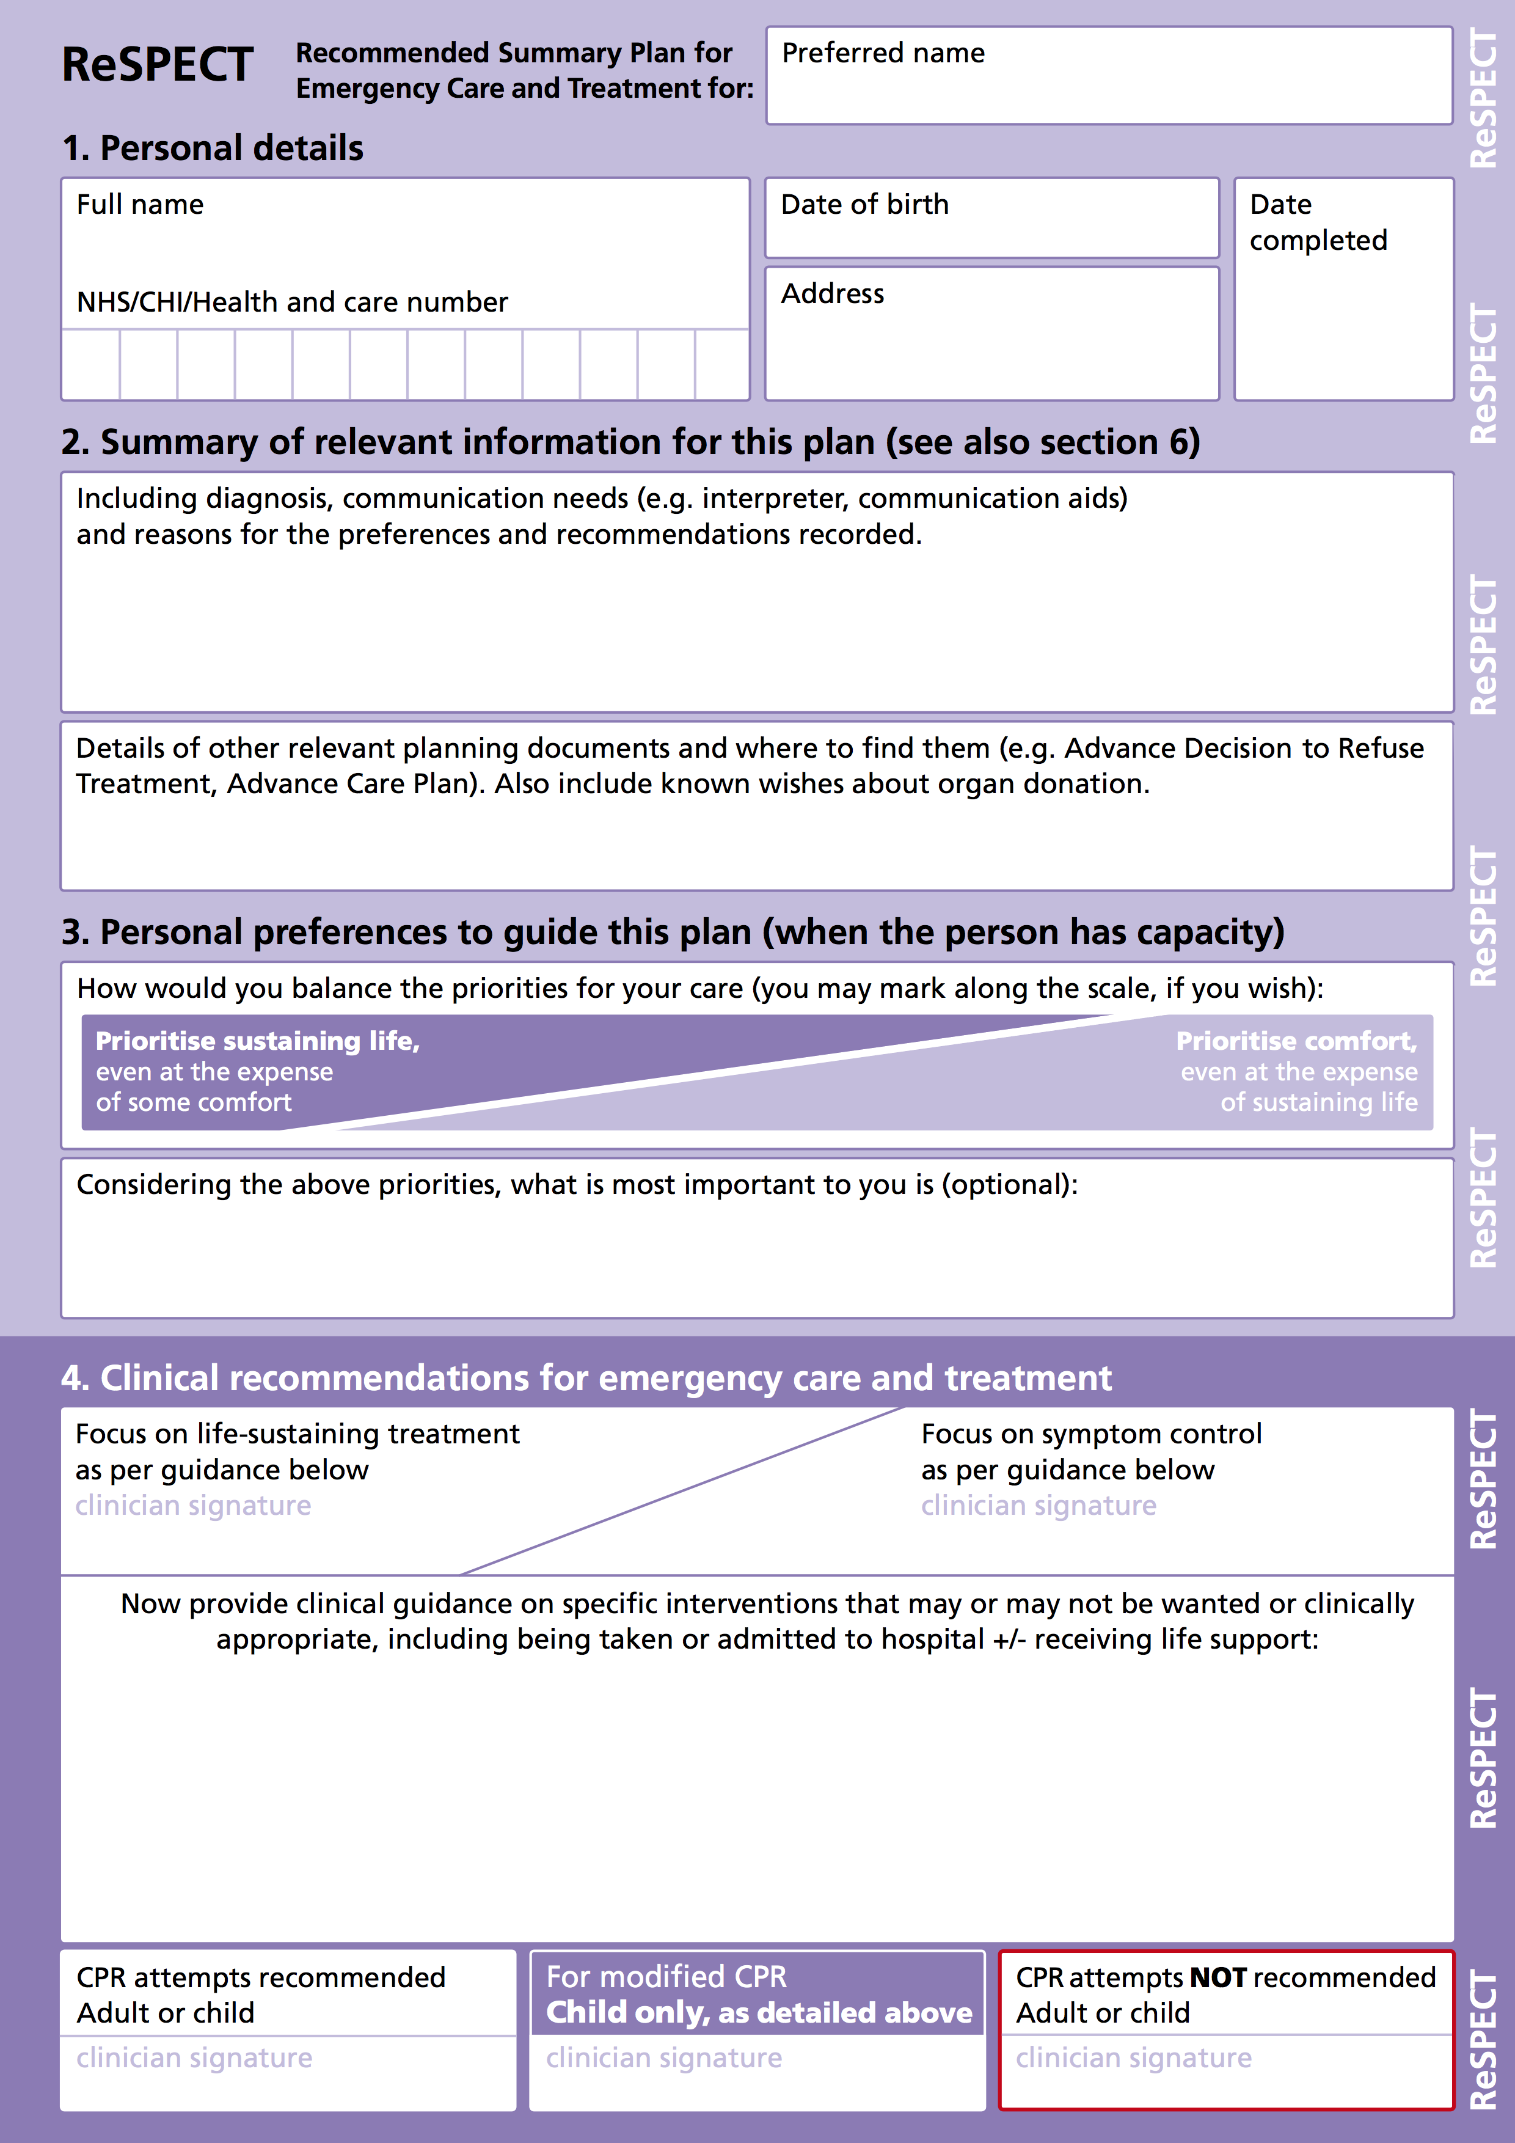
Completing ReSPECT form – 2
Discuss with the family the young person’s condition and prognosis and any special needs - summarise these
Ask about and record details of other plans or documents
(e.g. CYPACP)
ReSPECT — young person

Slide 10
Completing a ReSPECT form – 3
You may use this scale to help the family understand the balance between priorities of care and identify their priority for the young person
Record (if they wish) the aspect(s) of life most important to the young person
ReSPECT — young person

Slide 11
Completing a ReSPECT form – 4a
Sign to indicate the agreed main focus of care
List elements of emergency care and treatment that
should be considered
they would not want
would not work in the young person’s situation
Include whether or not they would want the young person to be taken to hospital and in what circumstances
ReSPECT — young person

Slide 12
Completing a ReSPECT form – 4b
Remember that all recommendations
should be shared decisions
whenever possible
ReSPECT — young person

Slide 13
Completing a ReSPECT form – 4c
Sign a recommendation about CPR
If a ’modified’
resuscitation sequence is agreed
Sign the middle box
Record agreed modifications above
ReSPECT — young person

Slide 14
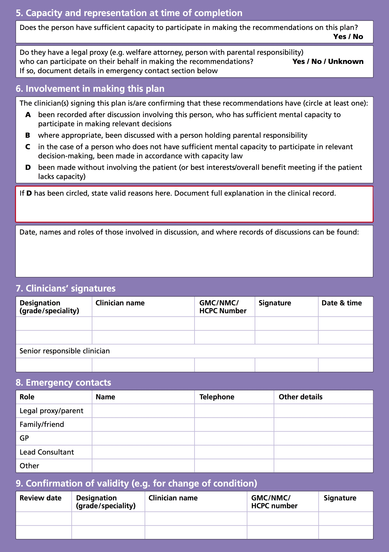
ReSPECT
Having completed discussion, shared decision-making and
recording…
… turn over the form to verify the basis for the agreed recommendations
ReSPECT — young person

Slide 15
Completing a ReSPECT form – 5
Indicate here whether or not the young person is
competent in respect of these decisions
Indicate here whether or not there is a person with parental responsibility
ReSPECT — young person

Slide 16
Completing a ReSPECT form – 6
Circle A to confirm involvement of a competent young person and/or B to indicate involvement of a parent
Circle D if there has been no involvement of either
If there has been no involvement of the young person state valid reasons here
Record dates of discussions and names and roles of those involved, including any court ruling
ReSPECT — young person

Slide 17
Completing a ReSPECT form – 7
Complete this line in full to confirm that you have completed the form accurately
The senior responsible clinician should be aware of and agree to this plan. If you are not that clinician they should be asked to endorse it by completing this line at the earliest practicable opportunity
ReSPECT — young person

Slide 18
Completing a ReSPECT form – 8
List name and contact details of all those who must be contacted
and those that the young person and parents would want contacted
in an emergency (and are willing to be contacted)
ReSPECT — young person

Slide 19
Completing a ReSPECT form – 9
Leave this box blank at initiation
When a young person’s condition changes or they move from one care setting to another (including a change of hospital ward) a senior clinician should review the ReSPECT recommendations, in discussion with the parent(s), and
sign and date here to confirm that they are still valid OR
cancel this form and create a new revised one
ReSPECT — young person

Slide 20
Summary
If appropriate and if time allows, use advance care planning to inform content of the ReSPECT form
Make shared decisions for the current situation
Work through ReSPECT systematically to establish ▫ the background to the recommendations ▫ the parent’s preferences for care and treatment ▫ agreed clinical recommendations
Complete page 2 fully to confirm the validity of the plan
ReSPECT — young person

